Slide 1

cv
Night Vision Image: Fusion of low-light visible and thermal IR imagery
Team Members
Nitin P Khatawate
Soumil Biswas
ShivPrasad Achari
Tanish V Sugnani
Under the Guidance of
Mrs. Shubha Bhat and Mr. Shashidhara Bola
Asst. Professor, Dept of Computer Science and Engineering
Department of Computer Science & Engineering, DSCE

Slide 2
Contents
Introduction
Objective and Problem Statement
Literature Survey
Existing Techniques
Proposed System
System Requirements and Expected Results
Conclusion and Future Work
References

Slide 3
cv
INTRODUCTION
In computer vision, Multisensor Image fusion is the process of combining relevant information from two or more images into a single image. The resulting image will be more informative than any of the input images.
Real-time implementation of the dual sensor fusion system combines imagery from either a low-light CCD camera or a short-wave infrared camera, with thermal long-wave infrared imagery.
Multi-sensor based image fusion system is a fundamental to several modern day image processing applications, such as security systems, defence applications, and intelligent machines.
In this paper, we concentrate on the fusion of multi-sensor data such as thermal infrared (IR) and visible images, which can lead to better performance for human visual perception, object detection, as well as target recognition .
The goal of image fusion is to identify the most important information in the source images and to transfer, without distortion or loss, this information into a fused image.
Department of Computer Science & Engineering, DSCE

Slide 4
cv
OBJECTIVE AND PROBLEM STATEMENT
The main objective is to develop a new prototype system which combines an IR and visible sensor to enable the detection and surveillance of pedestrians over a period of time. More specifically, in an environment where pedestrians are moving within an area affected by various lighting and atmospheric conditions.
In night-time environment, only limited visual information can be captured by CCD cameras under poor lightning conditions, thus making it difficult to do surveillance only by visual sensor.
Department of Computer Science & Engineering, DSCE

Slide 5
cv
LITERATURE SURVEY
[SCI-E] Minjae Kim, David K. Han, and Hanseok Ko, "Joint Patch Clustering-based Dictionary Learning for Multimodal Image Fusion",Information fusion, Vol.27, pp.198-214, Jan 2015.
Minjae Kim, David K. Han, and Hanseok Ko, "Multimodal Image Fusion Via Sparse Representation With Local Patch Dictionaries", 2013 IEEE International Conference on Image Processing (ICIP),pp. 1301-1305, Melbourne, Australia, September 15-18, 2013
Jeongmin Bae, Bonwha Ku, David K. Han, and Hanseok Ko, "Combining Infrared and Visible Images using Novel Transform and Statistical Information", IEEE Ninth International Conference on Advanced Video and Signal-Based Surveillance, pp.149-153, Beijing, China, September 18-21, 2012
Fusion of Multi-Sensor Imagery for Night Vision:Color Visualization, Target Learning and Search1 D.A. Fay, A.M. Waxman, M. Aguilar2, D.B. Ireland, J.P. Racamato, W.D. Ross, W.W. Streilein, and M.I. BraunMassachusetts Institute of Technology
J. Ma, J. Zhao, Y. Ma, J. Tian, Non-rigid visible and infrared face registration via regularized gaussian ﬁelds criterion, Pattern Recognition 48 (3) (2015) 772–784.
Department of Computer Science & Engineering, DSCE

Slide 6
cv
Existing Techniques
1. Some well-known existing image fusion methods are:
High pass filtering technique
IHS transform based image fusion
PCA based image fusion
Wavelet transform image fusion
Pair-wise spatial frequency matching
Department of Computer Science & Engineering, DSCE

Slide 7
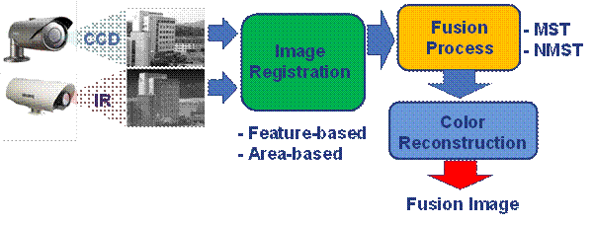
cv
PROPOSED SYSTEM
Register two input images to have same field of views.
Generate fused image by multi-scale transform (MST) or Non-multi scale transform method.
Apply colour reconstruction processing for natural image.
Department of Computer Science & Engineering, DSCE

Slide 8
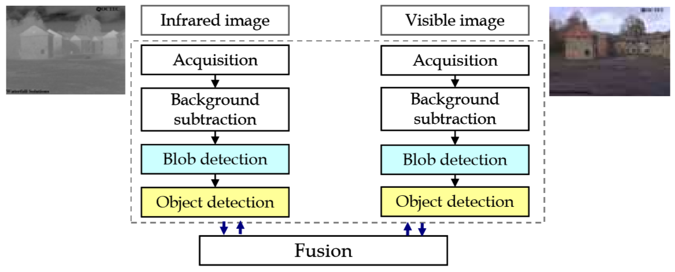

Slide 9
cv
SYSTEM REQUIREMENTS AND EXPECTED RESULTS
Hardware Requirements
CCD Camera
IR Camera
Software Requirements
Language : MATLAB scripting languade
Operating System : Windows
Platform :MATLAB
The MATLAB application is built around the MATLAB scripting language. Common usage of the MATLAB application involves using the Command Window as an interactive mathematical shell or executing text files containing MATLAB code.
Department of Computer Science & Engineering, DSCE

Slide 10
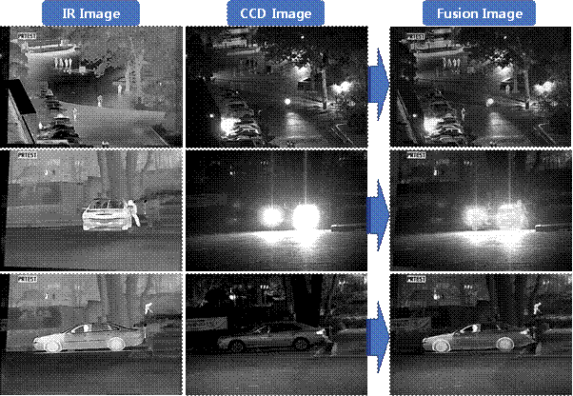

Slide 11
cv
CONCLUSION AND FUTURE WORK
The proposed method estimates the parallax point by appending both input images and IR image is registered. Using a novel method based on techniques like wavelet packet transformation (WPT) model image fusion Is performed considering analysis of input signal at different scale and resolution. In order to perform wavelet packet transformation where Fourier domains are incorporated with high and low band pass filter for estimating mean and maximum fusion values. And also we have done a comparative analysis for ensuring the effectiveness of the proposed system WPT. Our scheme developed to perform SIFT feature extraction as well as estimating parallax point, registration and finally fusion of images.
.
Department of Computer Science & Engineering, DSCE

Slide 12
APPLICATIONS OF IMAGE FUSION
Image combination discovers application in an extensive variety of regions including image preparing. A portion of the ranges which find discriminating application of image combination are as the accompanying.
1. intelligent robots
a) require movement control, in light of input from the earth from visual, material, energy/torque, and different sorts of sensors b) Stereo camera combination c) Intelligent survey control d) Automatic target distinguishment and following
2. Medical image
a) Fusing X-beam registered tomography (CT) and attractive reverberation (MR) images b) Computer supported surgery c) Spatial enlistment of 3-D surface

Slide 13
3. Manufacturing
a) Electronic circuit and part of inspection b) Product surface estimation and assessment c) Non-destructive material inspection d) Manufacture process monitoring e) Complex machine/device diagnostics f) Intelligent robots on assembly lines
4. Military and law enforcement
a) Detection, tracking, identification of ocean (air, ground)target/event b) Concealed weapon detection c) Battle-field checking d) Night pilot direction
5. Remote sensing
a) using different parts of the electro-attractive range b) Sensors: from black-and-white routed photography to multi-spectral active microwave space-borne imaging radar

Slide 14
cv
REFERENCES
[SCI-E] Minjae Kim, David K. Han, and Hanseok Ko, "Joint Patch Clustering-based Dictionary Learning for Multimodal Image Fusion",Information fusion, Vol.27, pp.198-214, Jan 2015.
Minjae Kim, David K. Han, and Hanseok Ko, "Multimodal Image Fusion Via Sparse Representation With Local Patch Dictionaries", 2013 IEEE International Conference on Image Processing (ICIP),pp. 1301-1305, Melbourne, Australia, September 15-18, 2013
Jeongmin Bae, Bonwha Ku, David K. Han, and Hanseok Ko, "Combining Infrared and Visible Images using Novel Transform and Statistical Information", IEEE Ninth International Conference on Advanced Video and Signal-Based Surveillance, pp.149-153, Beijing, China, September 18-21, 2012
Fusion of Infrared and Visible Images for Robust Person Detection - Thi Thi Zin, Hideya Takahashi, Takashi Toriu and Hiromitsu Hama Graduate School of Engineering, Osaka City University, Osaka 558-8585 Japan
J. Ma, J. Zhao, Y. Ma, J. Tian, Non-rigid visible and infrared face registration via regularized gaussian ﬁelds criterion, Pattern Recognition 48 (3) (2015) 772–784.
Department of Computer Science & Engineering, DSCE

Slide 15
cv
THANK YOU
Department of Computer Science & Engineering, DSCE

